Slide 1


Slide 2
Ravi Kumar Singh
(Team lead)
2230840
Payal Rawat
2230823
BOTGuidedPathways
Team
Sakshi kumari
2230857
Prateek Singh Jadon
2230829

Slide 3


Slide 4
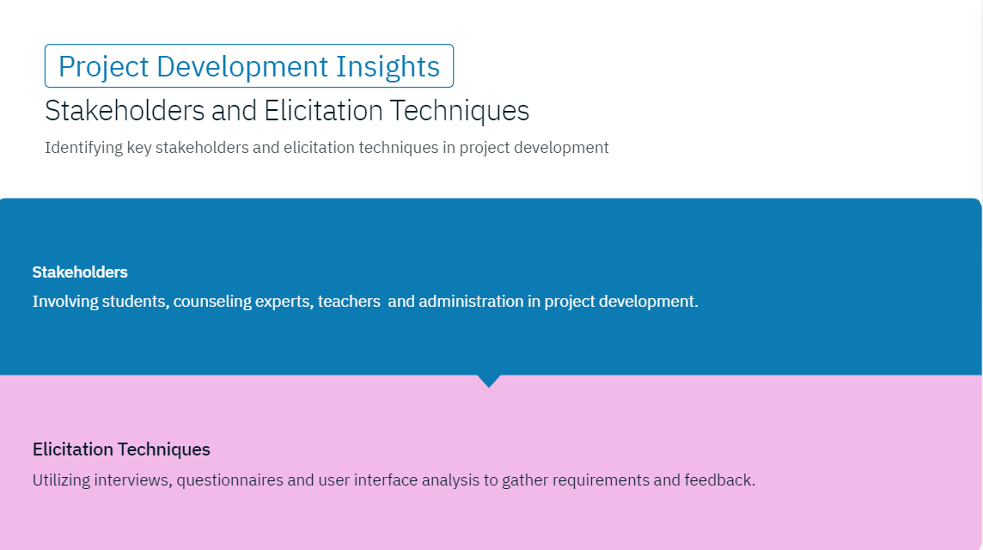

Slide 5
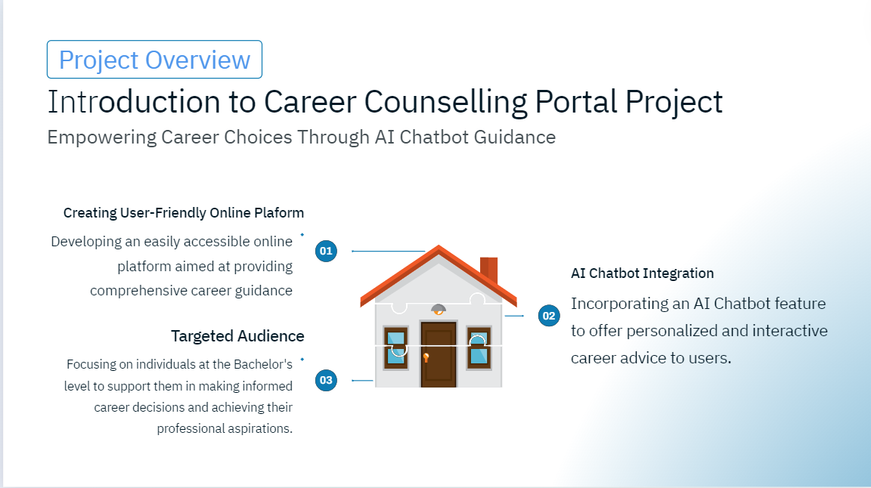

Slide 6
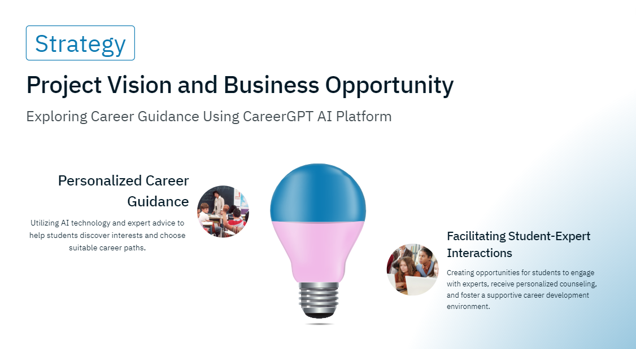

Slide 7
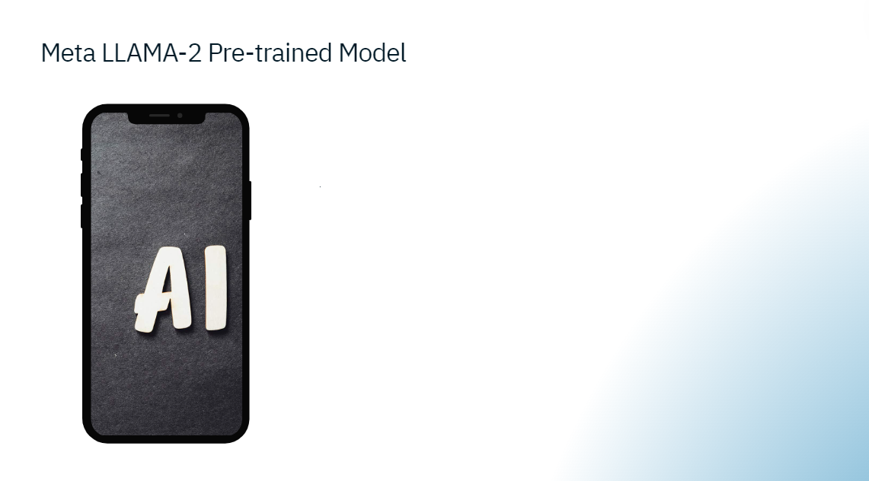
Utilization of Meta LLAMA-2 pre-trained model specifically designed for offering career advice to intermediate level students.

Slide 8
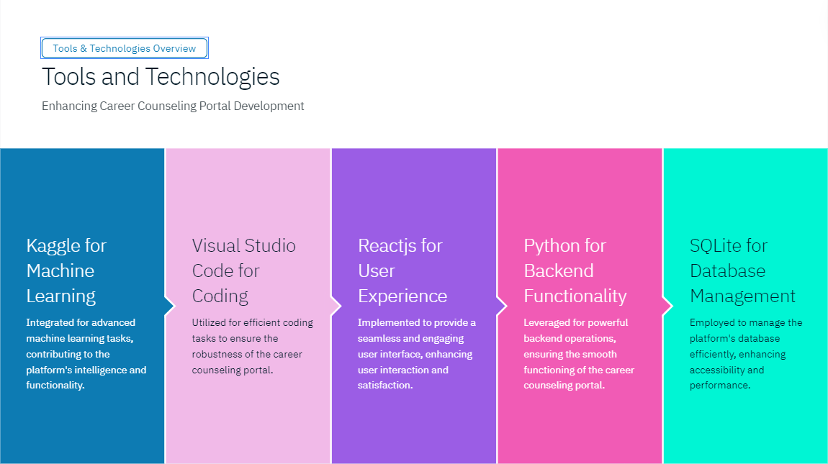






Slide 9
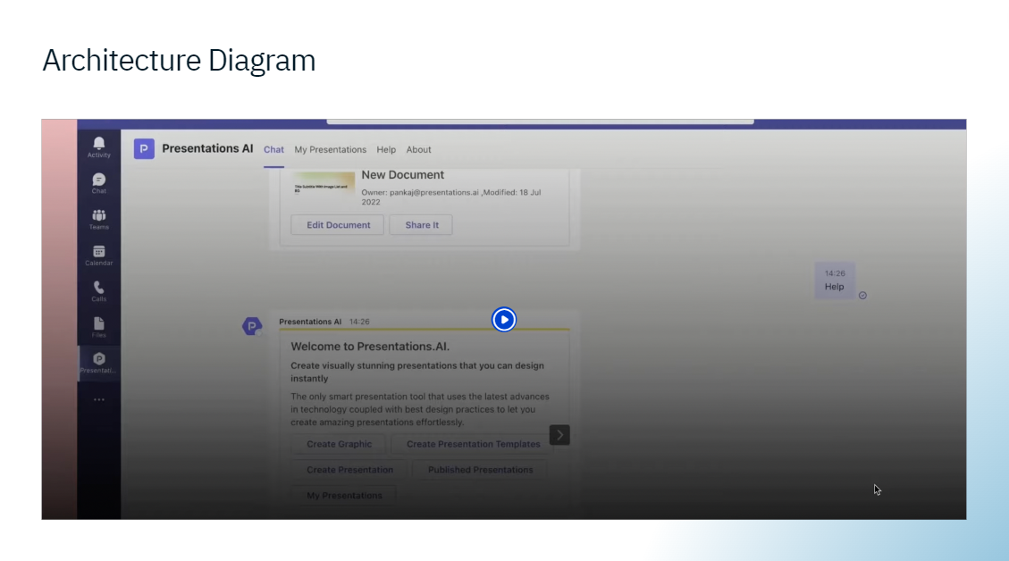
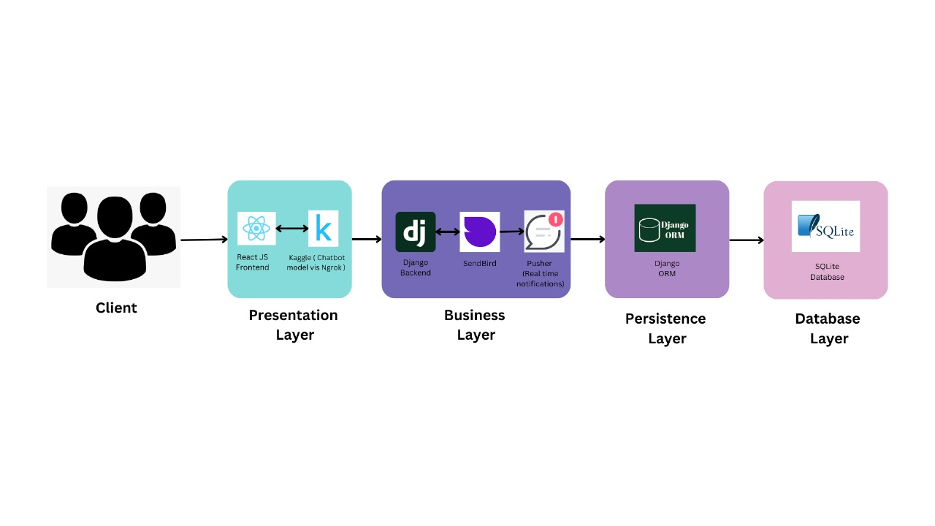

Slide 10
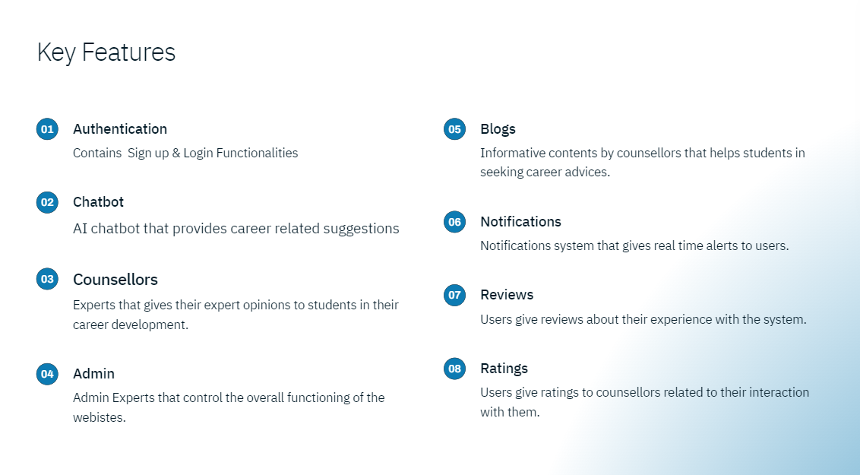

Slide 11
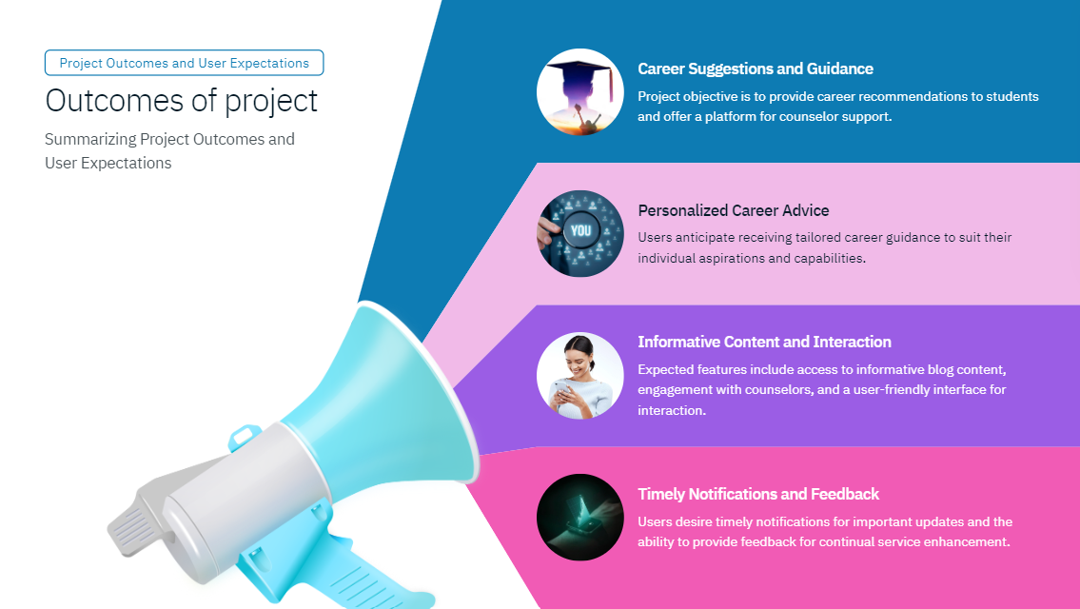

Slide 12
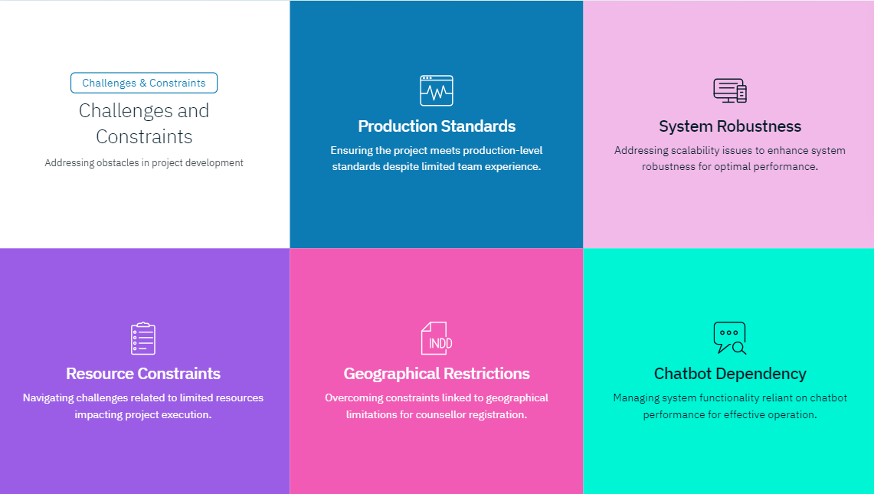

Slide 13


